Slide 1
Work Breakdown Structure (WBS)
The WBS represents a logical decomposition of the work to be performed and focuses on how the product, service, or result is naturally subdivided. It is an outline of what work is to be performed.
LEVEL | ELEMENT DESCRIPTION
1 | Project
2 | Category
3 | Subcategory
4 | Sub-Subcategory
5 | Work Package

Slide 2
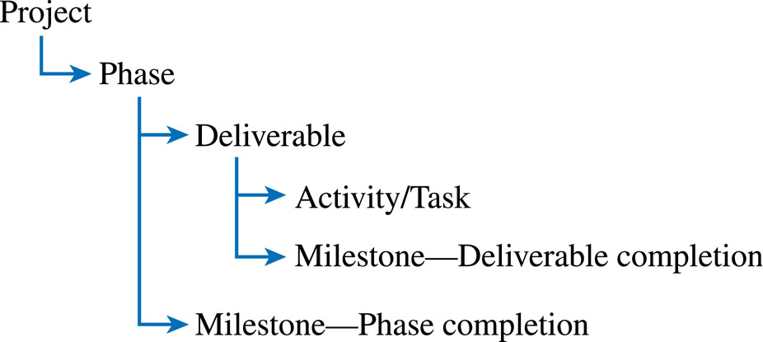
Work Package

Slide 3
Deliverables and Milestones
Deliverables
  Tangible, verifiable work products
  Reports, presentations, prototypes, etc.
Milestones
  Significant events or achievements
  Acceptance of deliverables or phase completion
  Cruxes (proof of concepts)
  Quality control
  Keeps team focused

Slide 4
Example of WBS: “Holiday”
holiday
travel
documents
booking
household
passport
tickets
choose
resort
confirm
cat!
insurance
brochures
Chapter 5 Planning

Slide 5
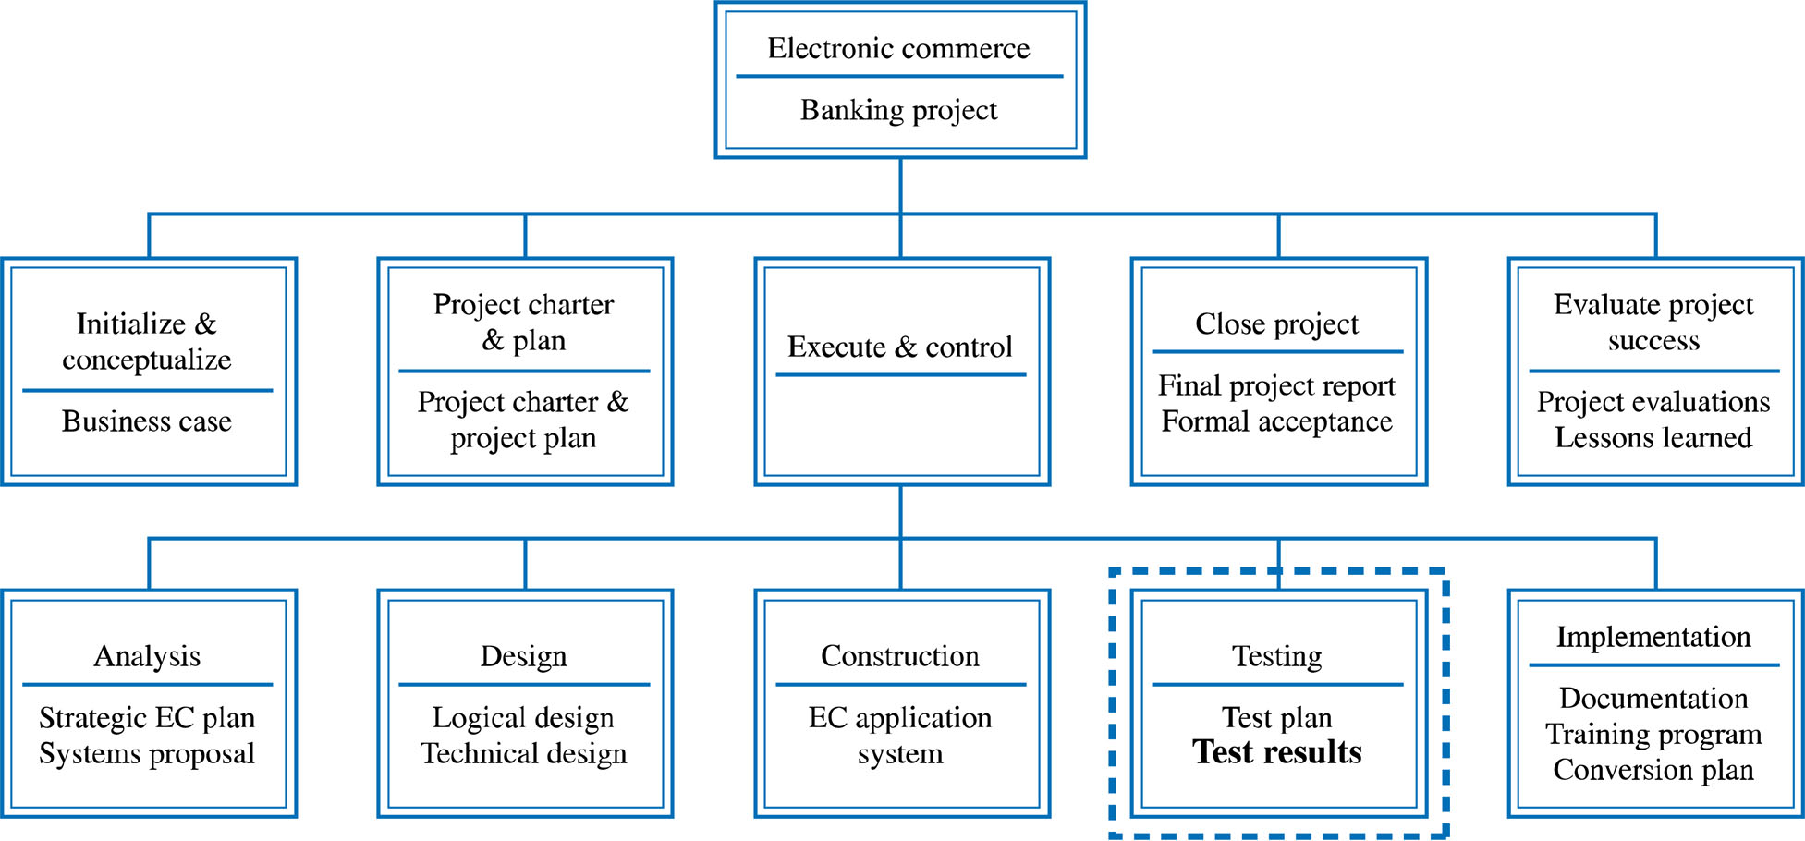
Developing the WBS

Slide 6
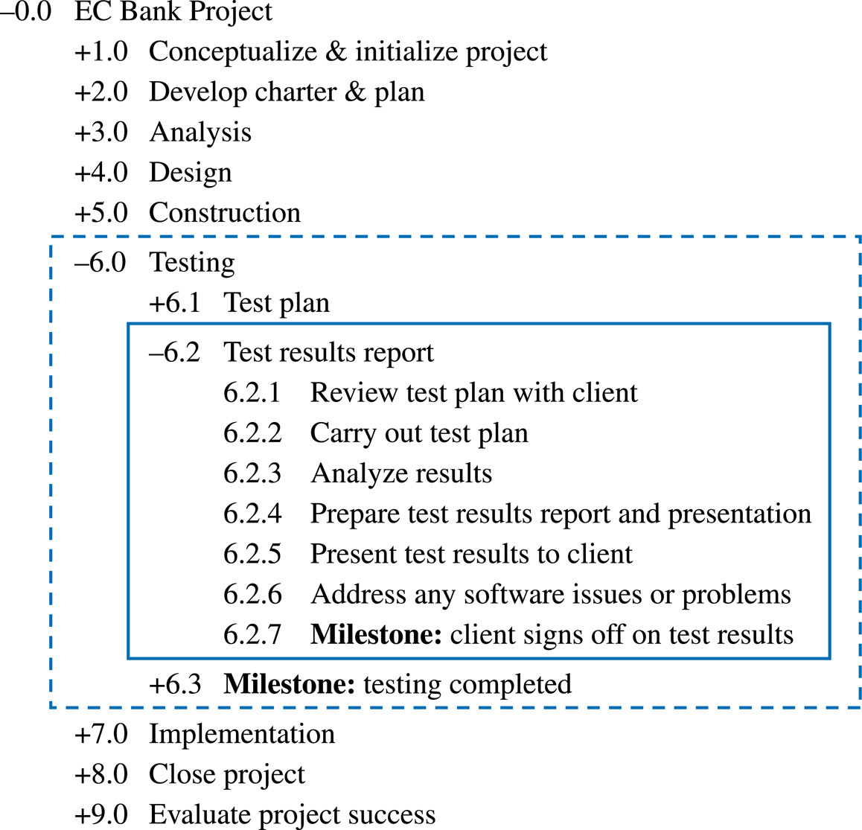
Example Work Breakdown Schedule

Slide 7
The WBS Should Follow the Work Package Concept

Slide 8
Developing the WBS
The WBS Should Be Deliverable-Oriented
The WBS Should Support the Project's MOV
  Ensure WBS allows for the delivery of all the project’s deliverables as defined in project scope
  100 percent rule
The Level of Detail Should Support Planning and Control
Developing the WBS Should Involve the People Who Will Be Doing the Work
Learning Cycles and Lessons Learned Can Support the Development of a WBS

Slide 9
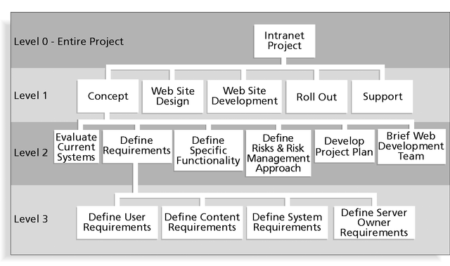

Slide 10
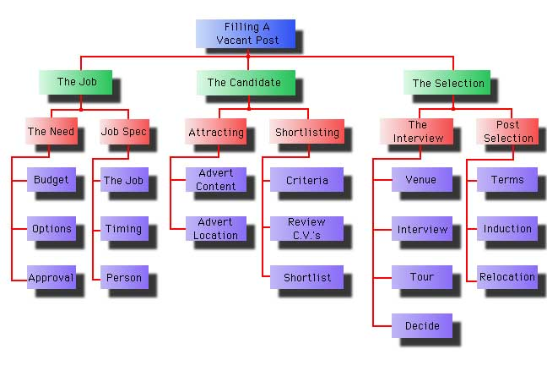

Slide 11
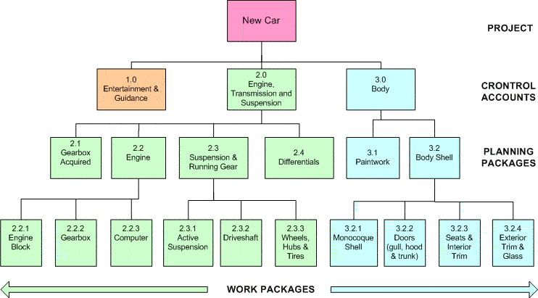

Slide 12
Responsibility Matrix
Intersection of WBS and organization structure
Rows = persons or functional positions
Columns = work tasks or packages for which each personnel is responsible
Useful for monitoring and control

Slide 13
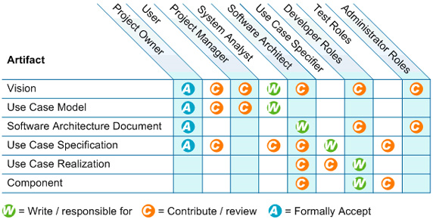

Slide 14
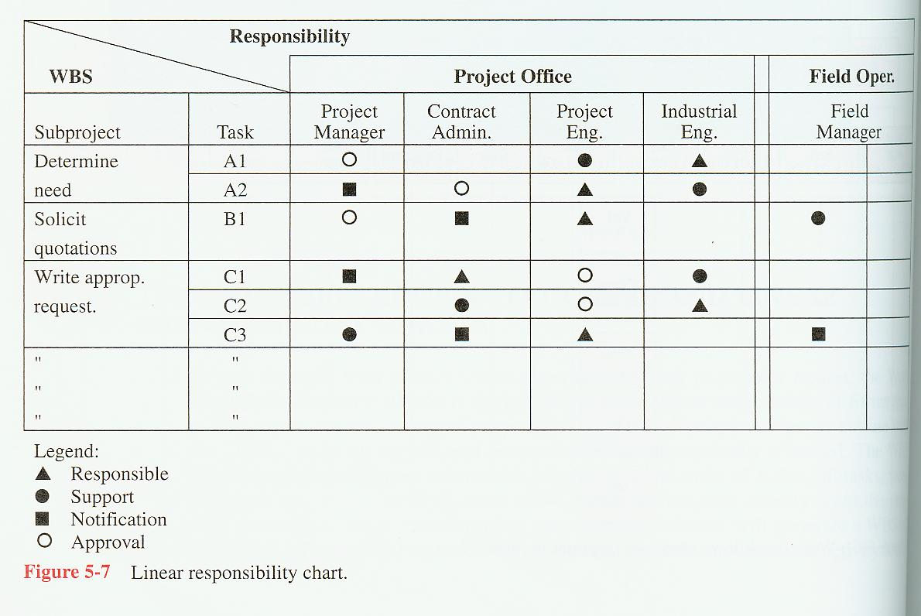

Slide 15
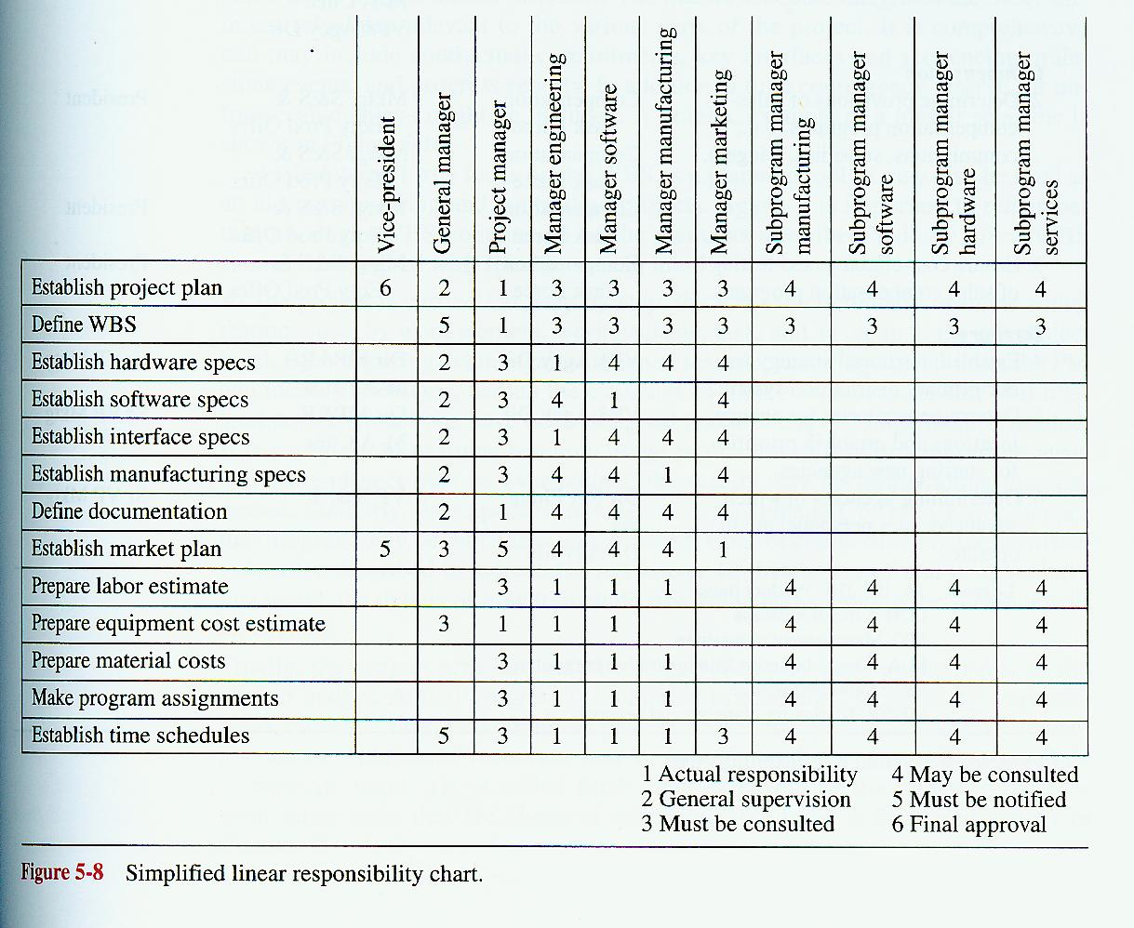

Slide 16
Estimation Techniques
- The Project Management Approach
Guesstimating
Delphi Technique
Time Boxing
Top-Down
Bottom Up
Analogous Estimates (Past experiences)
Parametric Modeling (Statistical)

Slide 17
Project Estimation
Guesstimating
  Based on feeling and not facts
  Not a good method for estimating but often used by inexperienced project managers
Delphi Technique
  Involves multiple, anonymous experts
  Each expert makes an estimate
  Estimates compared
    If close, can be averaged
    Another iteration until consensus is reached

Slide 18
Project Estimation
Time Boxing
  A “box” of time is allocated for a specific activity, task, or deliverable
  Can focus a team if used effectively
  Can demoralize a team if used too often or ineffectively because of the increased stress or pressure on the project team to get things done

Slide 19
Project Estimation
Top-Down Estimating
  Top and middle managers determine overall project schedule and/or cost.
  Lower level managers are expected to breakdown schedule/budget estimates into specific activities (WBS).
  Often couched in terms of what a project should cost and how long it should take as decreed by a member of top management who thinks those parameters are appropriate.
  May be a response to the business environment.
  May lead to a death march project.

Slide 20
Project Estimation
Bottom-Up Estimating
  Most common form of project estimation
  Schedules & budgets are constructed from the WBS
  Starts with people who will be doing the work
  Schedules & budgets are the aggregate of detailed activities & costs

Slide 21
Project Estimation
Analogous estimating
  based on similarity between current projects and others
  Use information from previous, similar projects as a basis for estimation

Slide 22
Project Estimation
Parametric Modeling
  Use project characteristics (parameters) in a mathematical model to estimate
  Example: $50/ LOC based on:
    Programming language
    Level of expertise
    Size & complexity

